Slide 1
Book1
File created on: 02-11-2024 15:34:41

Slide 2
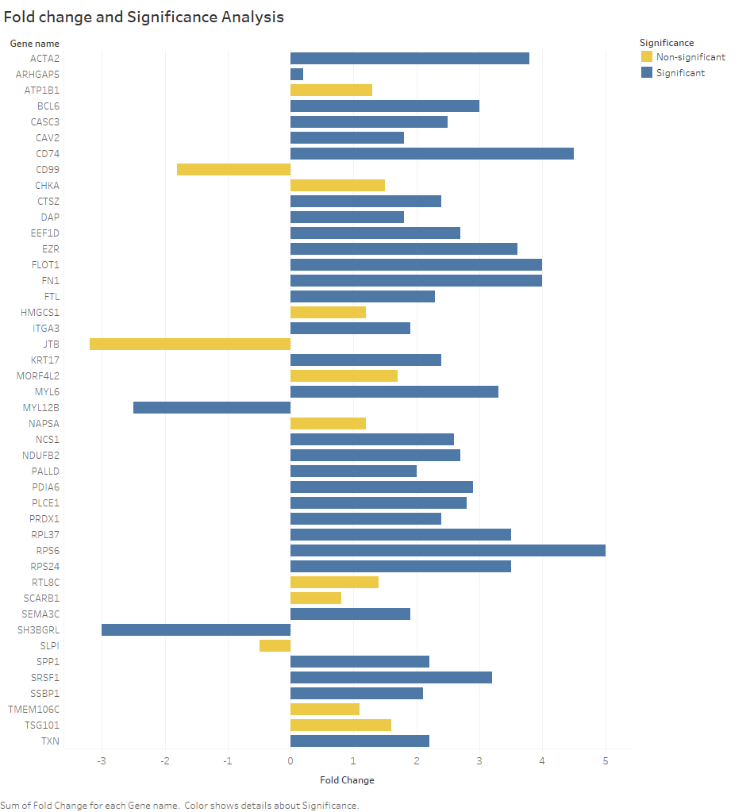

Slide 3
